Slide 1
Fixed income
Module1 Fixed-Income Securities : Defining Elements
Module2 Fixed-Income Markets : Issuance, Trading, and Funding
Module3 Introduction to Fixed-Income Valuation
Module4 Introduction to Asset-Backed Securities
Module5 Understanding Fixed-Income Risk and Return
Module6 Fundamentals of Credit Analysis

Slide 2
Module5 Understanding Fixed-Income Risk and Return
Sources of return
Fixed-rate bond investors have three sources of return:
(1) receipt of promised coupon and principal payments on the scheduled dates,
(2) reinvestment of coupon payments, and
(3) potential capital gains or losses on the sale of the bond prior to maturity

Slide 3
Module5 Understanding Fixed-Income Risk and Return
In each of the six examples, an investor initially buys a 10-year, 8% annual coupon payment bond at a price of 85.503075 per 100 of par value. The bond’s yield-to-maturity is 10.40%.
Example 1:
A “buy-and-hold” investor purchases a 10-year, 8% annual coupon payment bond at 85.503075 per 100 of par value and holds it until maturity. The coupon payments are reinvested at 10.40%.
Future value of coupon = 8*1.1040⁹ + 8*1.1040⁸ + … + 8 = 129.970678
Total return = 229.970678
85.503075 * (1+r)¹⁰ = 229.970678 r=10.40%

Slide 4
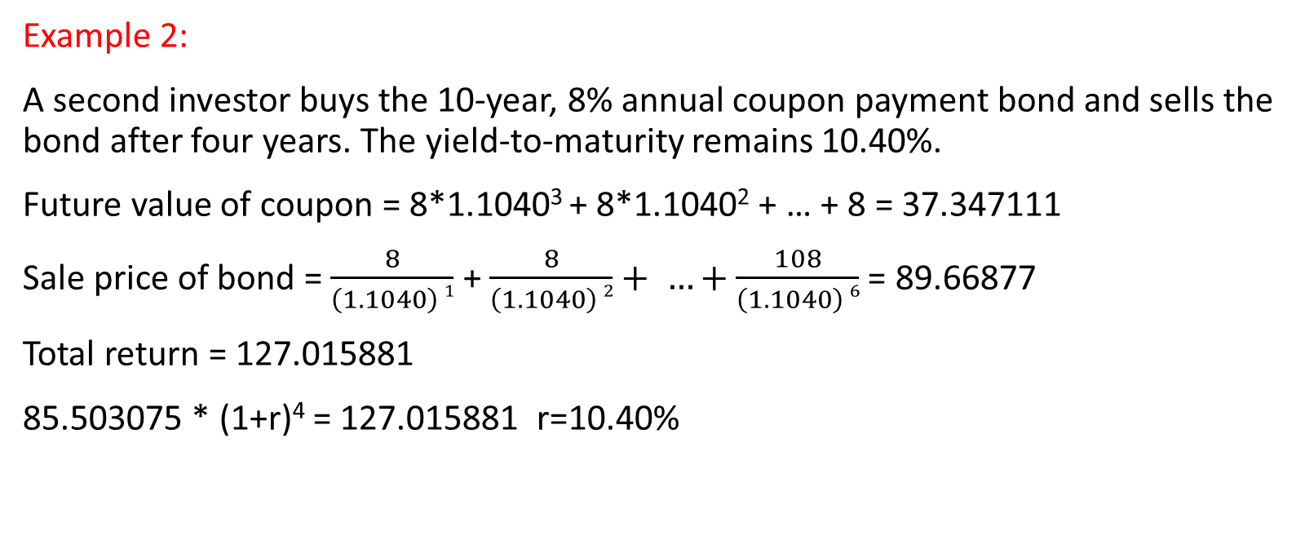
Module5 Understanding Fixed-Income Risk and Return
Example 2:
A second investor buys the 10-year, 8% annual coupon payment bond and sells the bond after four years. The yield-to-maturity remains 10.40%.
Future value of coupon = 8*1.1040³ + 8*1.1040² + … + 8 = 37.347111
Sale price of bond = $\frac{8}{\left(1.1040\right) 1}$ + $\frac{8}{\left(1.1040\right) 2}+ …+\frac{108}{\left(1.1040\right) 6}$ = 89.66877
Total return = 127.015881
85.503075 * (1+r)⁴ = 127.015881 r=10.40%

Slide 5
Module5 Understanding Fixed-Income Risk and Return
Example 3:
The buy-and-hold investor purchases the 10-year, 8% annual payment bond at 85.503075. After the bond is purchased and before the first coupon is received, interest rates go up to 11.40%.
Future value of coupon = 8*1.1140⁹ + 8*1.1140⁸ + … + 8 = 136.380195
Total return = 236.380195
85.503075 * (1+r)¹⁰ = 136.380195 r=10.70%

Slide 6
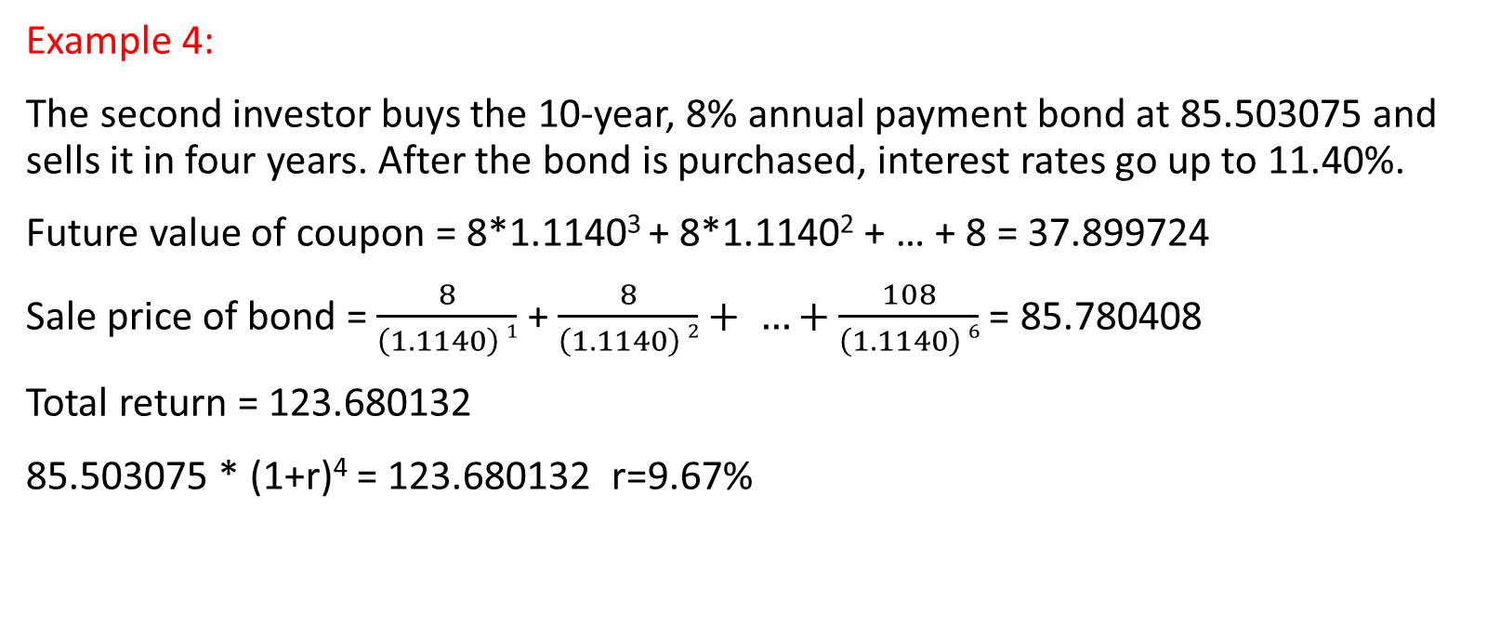
Module5 Understanding Fixed-Income Risk and Return
Example 4:
The second investor buys the 10-year, 8% annual payment bond at 85.503075 and sells it in four years. After the bond is purchased, interest rates go up to 11.40%.
Future value of coupon = 8*1.1140³ + 8*1.1140² + … + 8 = 37.899724
Sale price of bond = $\frac{8}{\left(1.1140\right) 1}$ + $\frac{8}{\left(1.1140\right) 2}+ …+\frac{108}{\left(1.1140\right) 6}$ = 85.780408
Total return = 123.680132
85.503075 * (1+r)⁴ = 123.680132 r=9.67%

Slide 7
Module5 Understanding Fixed-Income Risk and Return
Example 5:
The buy-and-hold investor purchases the 10-year bond at 85.503075 and holds the security until it matures. After the bond is purchased and before the first coupon is received, interest rates go down to 9.40%.
Future value of coupon = 8*1.0940⁹ + 8*1.0940⁸ + … + 8 = 123.888356
Total return = 223.888356
85.503075 * (1+r)¹⁰ = 223.888356 r=10.10%

Slide 8
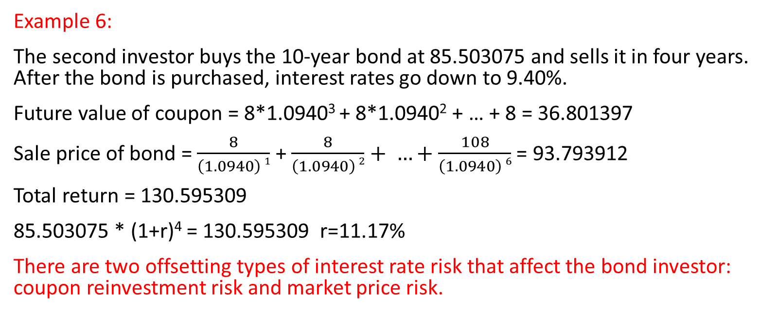
Module5 Understanding Fixed-Income Risk and Return
Example 6:
The second investor buys the 10-year bond at 85.503075 and sells it in four years. After the bond is purchased, interest rates go down to 9.40%.
Future value of coupon = 8*1.0940³ + 8*1.0940² + … + 8 = 36.801397
Sale price of bond = $\frac{8}{\left(1.0940\right) 1}$ + $\frac{8}{\left(1.0940\right) 2}+ …+\frac{108}{\left(1.0940\right) 6}$ = 93.793912
Total return = 130.595309
85.503075 * (1+r)⁴ = 130.595309 r=11.17%
There are two offsetting types of interest rate risk that affect the bond investor: coupon reinvestment risk and market price risk.

